Slide 1
CS2040/C
Week 13b, Finale

Slide 2
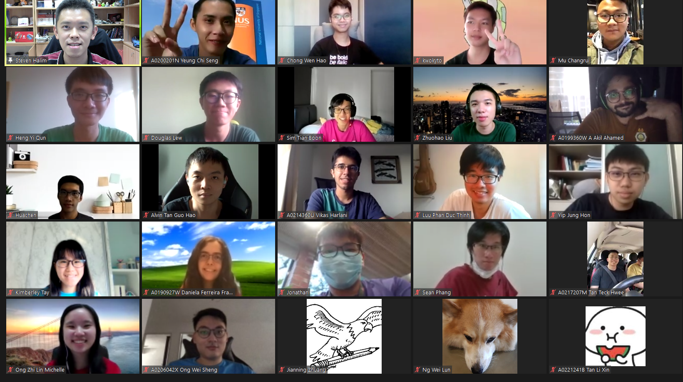

Slide 3
A few Parting Words (1)
The e-Lecture (flipped classroom) strategy + 100% online class is a mixed result…
Flipped classroom + live classes worked very well with 37 CS2040C S1 students, 173 CS2040C S2 students, 38 CS2040 S4 students two AYs ago, and also 96 CS2040C S1 students last AY, a total 344 students
It worked somewhat just okayish with a much bigger class last S2 of two AYs ago (269 students), harder to satisfy everyone
This sem, e-Lecture (flipped classroom) attendance is hovering around 80-90 before midterm, 60-70 before PE (week 11), to around 45-50 on week 12-13 :O…
Many have given up? Too busy with other modules? Etc?
I dropped polleverywhere in favor of Zoom participation survey/direct annotation/live chat
As usual, from the type of questions asked, these questions are dominated by some students most of the time

Slide 4
A few Parting Words (2)
With flipped classroom, I can do live problem solving in class
I think our rate is about ~1 Kattis problem per lecture and 1 during Lab
https://nus.kattis.com team is very supportive for this course ☺
NUS SoC is a paying customer
So there are ~30+ Kattis problems that we (I) have solved live in class this sem
If you (re-)AC them all, you should get near ~75 Kattis points by now (30*~2.5 points)
Preferably NOT BY COPYING MY CODE :S:S:S
You should have seen various algorithmic ideas and implementation strategies live
You have seen ~30+ examples on how “trivial/easy (Steven’s rating) algorithmic problems are solved using C++ (not just in vague pseudocode) in incredibly short amount of time :O, I think I only made very few live bugs throughout this semester
Aim to have skill like this in a few years time ☺, see your seniors: Matthew, Marc :O…
Notes:
About ~36+ in lecture, about 8+ in Lab

Slide 5
A few Parting Words (3)
Feedback on TAs
For me, all 5+1 Lab+Tut TAs (Wira, Yu Xiang, Walter, Arjo, Ivan+Nigel) are very helpful for the execution of this module
Special mention to ex-TA Matthew/rawr (graduated already but still helping a lot in Discord/various random consultations that he crashed in)
Give them your honest/individual feedback on what their classes ☺

Slide 6
To be done better (1)
Continuous e-Lecture slides gradual local refinements
Slightly more complete VisuAlgo e-Lecture material (most are quite good now)
Even more animated examples and in e-Lecture mini quizzes for self checks
I have taken note on slides that were proven still 'hard' for this batch, e.g., I immediately notice weak slides on /mst that I have not used for a few years yesterday
Future ultimate aim to have near 0 question about the basic material in future iterations of CS2040/C i.e. every e-Lecture slides are very self-explanatory :O… thereby putting my own lecturer job at risk :O
Continuous VisuAlgo OQ system refinements
Always add new questions/semester
Add a few that only appear in TEST mode
Close some aging technology loopholes (last major update Apr 2015 :O) especially to save session data (in case of failed submission/disruption midway)
I really need to overcome my web-development inertia ><

Slide 7
To be done better (2)
Continuous VisuAlgo system (overall) refinements
Improve/fix the print e-Lecture slides ability (for hard copy only tests) :O
Or actually create another short book on polished VisuAlgo slides ☺
Better user account features so that I can track students e-Lecture progresses in a much more fine grained mode (per slides?) :O,
Training mode status (the gamification feature), make it more engaging…
Less priority now: More complete translation to other languages (id/zh are at the highest translation state; the rest not so much), etc…

Slide 8
You (this batch) is the judge
NUS Teaching Feedback system has been opened since last Friday, 6 November 2020 until about Friday of reading week
Let’s see the live statistics as of now, it was just 20/115 (17.39%) on 12 Nov PM, we need at least ≥ 50% for the student feedback data to be representative enough
https://es.nus.edu.sg/Blue/

Slide 9
Final Assessment – Some Details
Of what I can reveal…
Assessed material: Everything :O, don’t forget the first half stuffs
Graph DS, Graph Traversal, and (especially) SSSP problems confirm appear
Using the same midterm-quiz format (that is easily parse-able)
Using e-Proctoring setup that you should be familiar with
But with a few staff proctors that probably new for you (not our mostly UG TAs)
No MCQ (too easy to leak out), but there will be short answers
Some questions are designed with stricter marking scheme (lesser partials) for quicker grading
My wife told me to design questions that are very trivial to answer (for me) after listening to my “feedback” about midterm and PE results

Slide 10
Reading Week Plan
Consultation in reading week is based on individual requests!
But preferably based on “group” requests (come in group!)
Make up/remedial PE https://nus.kattis.com/sessions/wnc9tm
Not many passed 138 threshold at https://nus.kattis.com/sessions/gvbdni
Wed, 18 Nov 2020, 10am-12pm, e-Proctoring…
With auto partial grading system, with some easier subtasks…
May or may not be moderated… (will be if very few joined, less likely if 2x25 students eventually joined)
No need to hide, one of the two re-PE tasks will be an SSSP(-related) task
So review all those shortest paths stuffs (treat this as final preparation too)
All the best for the final assessment
All the best for your life in general ☺

Slide 11
Still want to be tortured taught by me?
If you think your brain can take it, apply for CS3233 Jan-Apr 2021 or 2022 ☺
Preview → see https://www.comp.nus.edu.sg/~stevenha/cs3233.html
For my other module CS4234 in S1 Aug-Nov 2021, you need to clear CS3230 first, so take CS3230 in S2 Jan-Apr 2021 if you are interested
Those who get A- or above, apply for CS2040C S2 Jan-Apr 2021 TA
The lecturer will be Dr Alan Cheng
I will be his (head) TA :O…
I will come back to full time CS2040C (or other module) only on AY 2021/22 after the big https://ioi2021.sg/ is over
Some COVID-19 vaccines have recent good news, e.g., this or this news

Slide 12
THE END
for now…

